Slide 1
Installation of Anaconda in Windows

Slide 2

Installation of Python:
Go to https://www.anaconda.com/

Slide 3
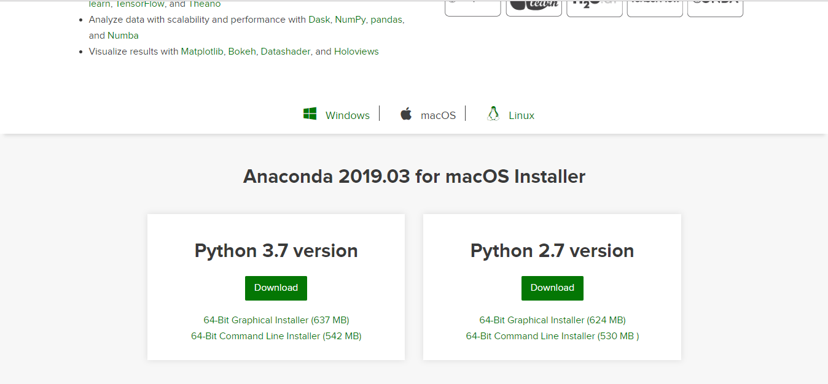
Installation of Python:
Click on Download and follow the steps on the screen. Finally you will be reaching on the following screen. Then select the appropriate option.

Slide 4
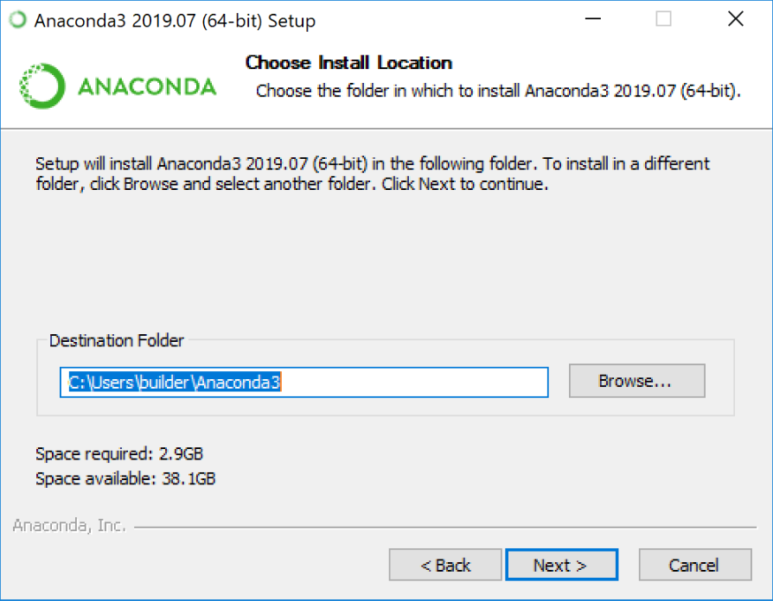
Installation of Python:
Double click the installer to launch.
Click Next
Read the licensing terms and click “I Agree”.
Select an install for “Just Me” unless you’re installing for all users (which requires Windows Administrator privileges) and click Next.

Slide 5
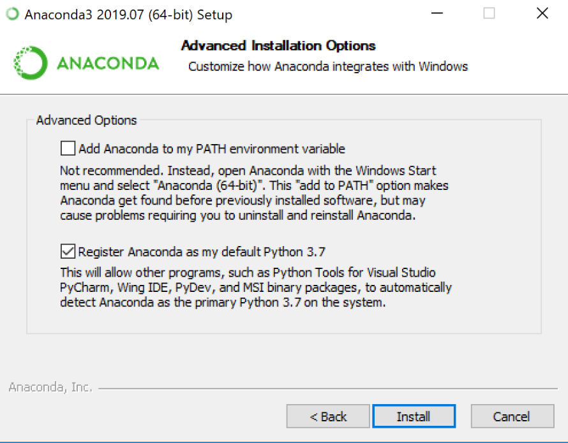
Installation of Python:
Choose whether to add Anaconda to your PATH environment variable. We recommend not adding Anaconda to the PATH environment variable, since this can interfere with other software. Instead, use Anaconda software by opening Anaconda Navigator or the Anaconda Prompt from the Start Menu.

Slide 6

Installation of Python:
Choose whether to register Anaconda as your default Python. Unless you plan on installing and running multiple versions of Anaconda or multiple versions of Python, accept the default and leave this box checked.
Click the Install button. If you want to watch the packages Anaconda is installing, click Show Details.
Click the Next button.

Slide 7
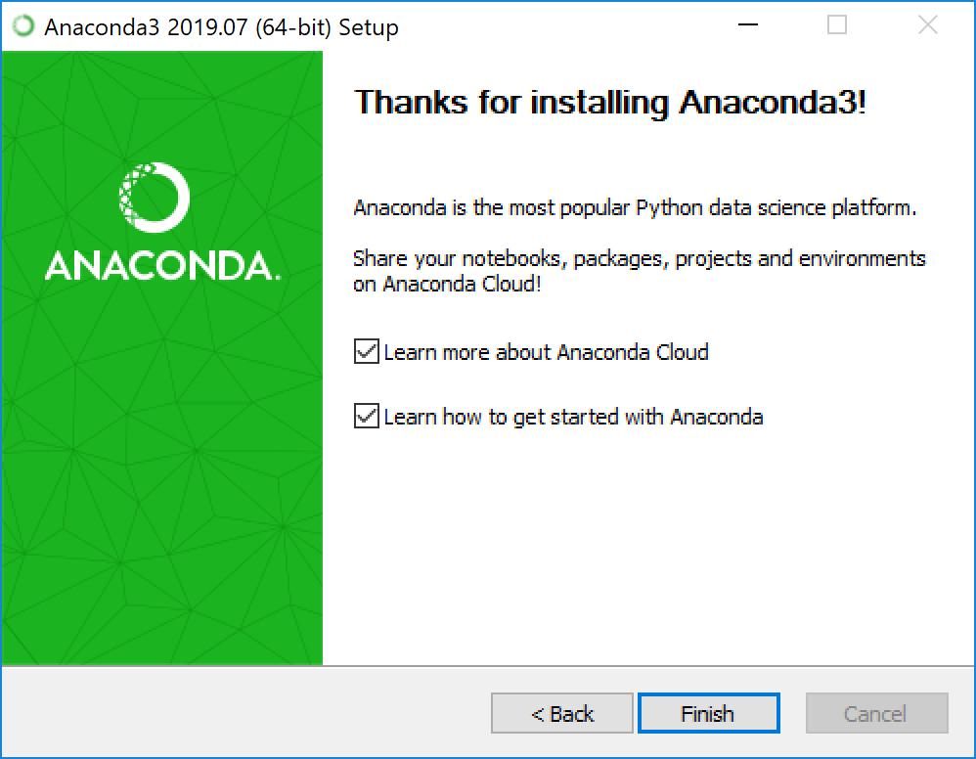
Installation of Python:
After a successful installation you will see the “Thanks for installing Anaconda” dialog box

Slide 8
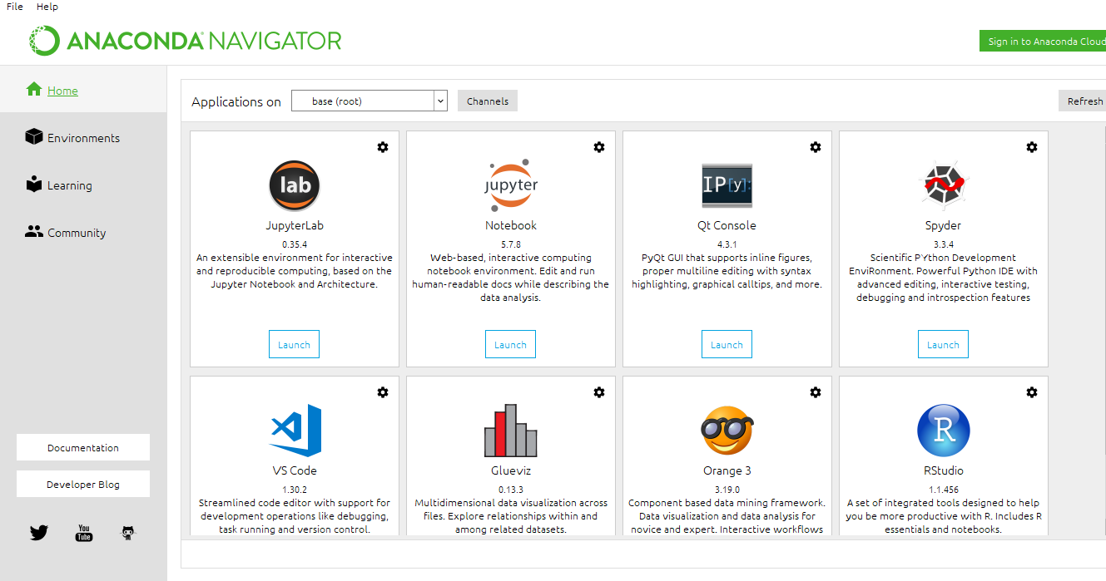
Installation of Python:
After installing anaconda, once you open it you will have the following screen. Do select Jupyter Notebook on this screen.

Slide 9
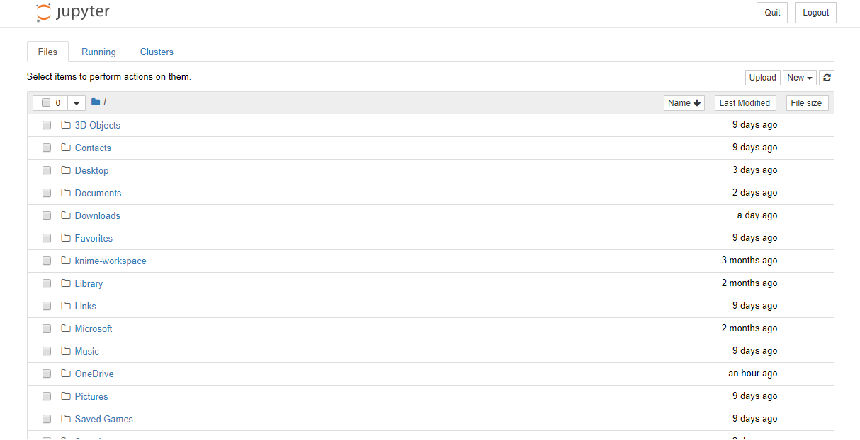
Opening Jupyter Notebook:
You will be directed to the following screen after you have opened Jupyter Notebook. Here, select new and you will be directed to a new Notebook.

Slide 10
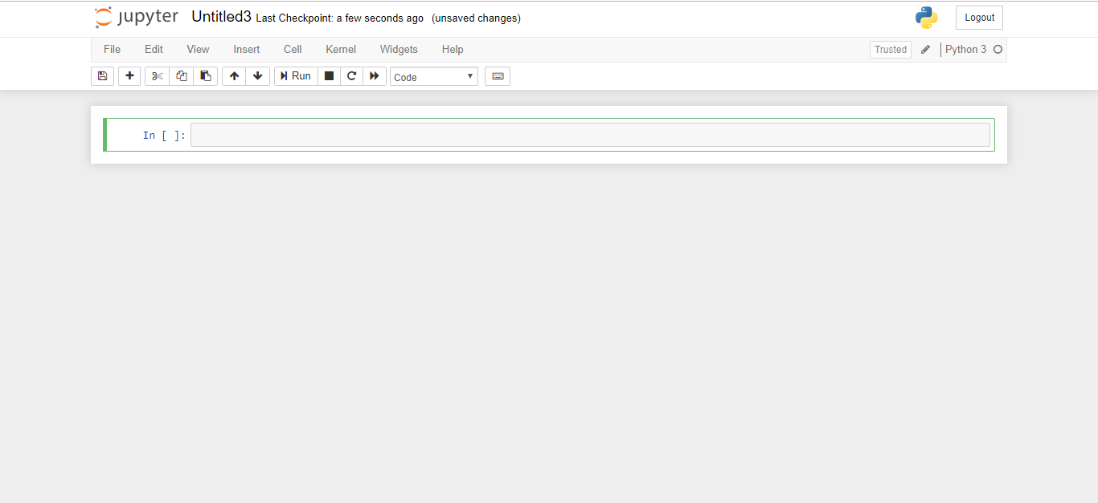
Opening Jupyter Notebook:
This is how a new Jupyter script looks like.

Slide 11
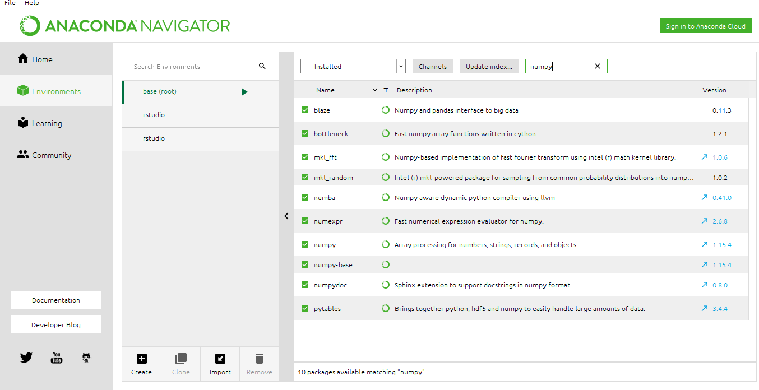
Installing Python Packages:
Go to Annaconda → Environment
Here you can type what package you want and install it.
As you can see, I am looking for numpy.

